Slide 1
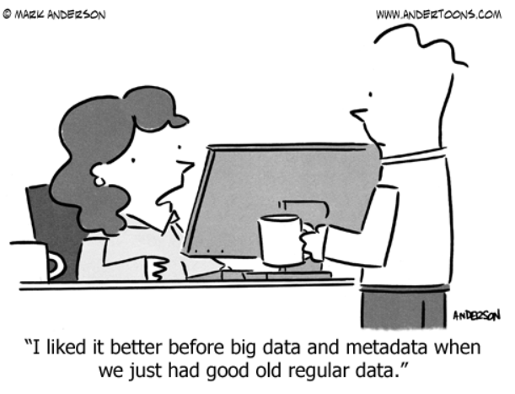
Cultivating a Culture of Digital Preservation Inside Academic Libraries and Out
Kelsey George,
Cataloging and Metadata Strategies Librarian
https://github.com/geokels
Image source: https://www.andertoons.com/data/cartoon/6826/liked-better-before-big-data-metadata-we-had-regular-data

Slide 2
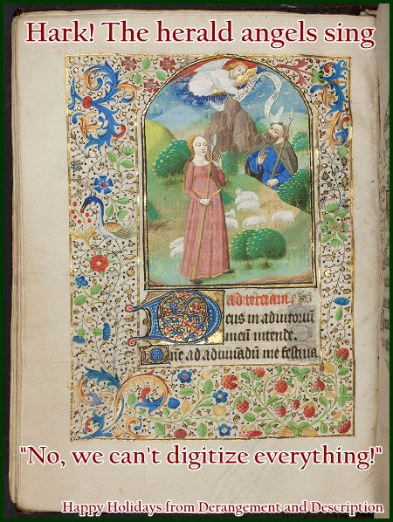
Digitization ≠ access.
Digitization ≠ preservation.
Digitization without a long term storage and preservation plan is a waste of time and resources.
Image credit: https://derangementanddescription.wordpress.com/2013/12/24/holiday-cards-for-archivists/
Notes:
Digitization is not always equivalent to access. Many obstacles exist when trying to make digitized materials accessible. Digital file formats are susceptible to bit rot

Slide 3
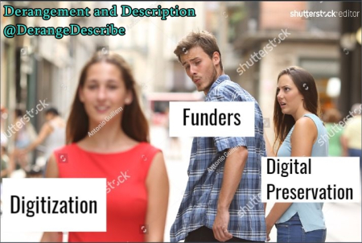
Image source: https://derangementanddescription.files.wordpress.com/2017/08/distracted_boyfriend_digitization.jpg?w=450&h=302

Slide 4
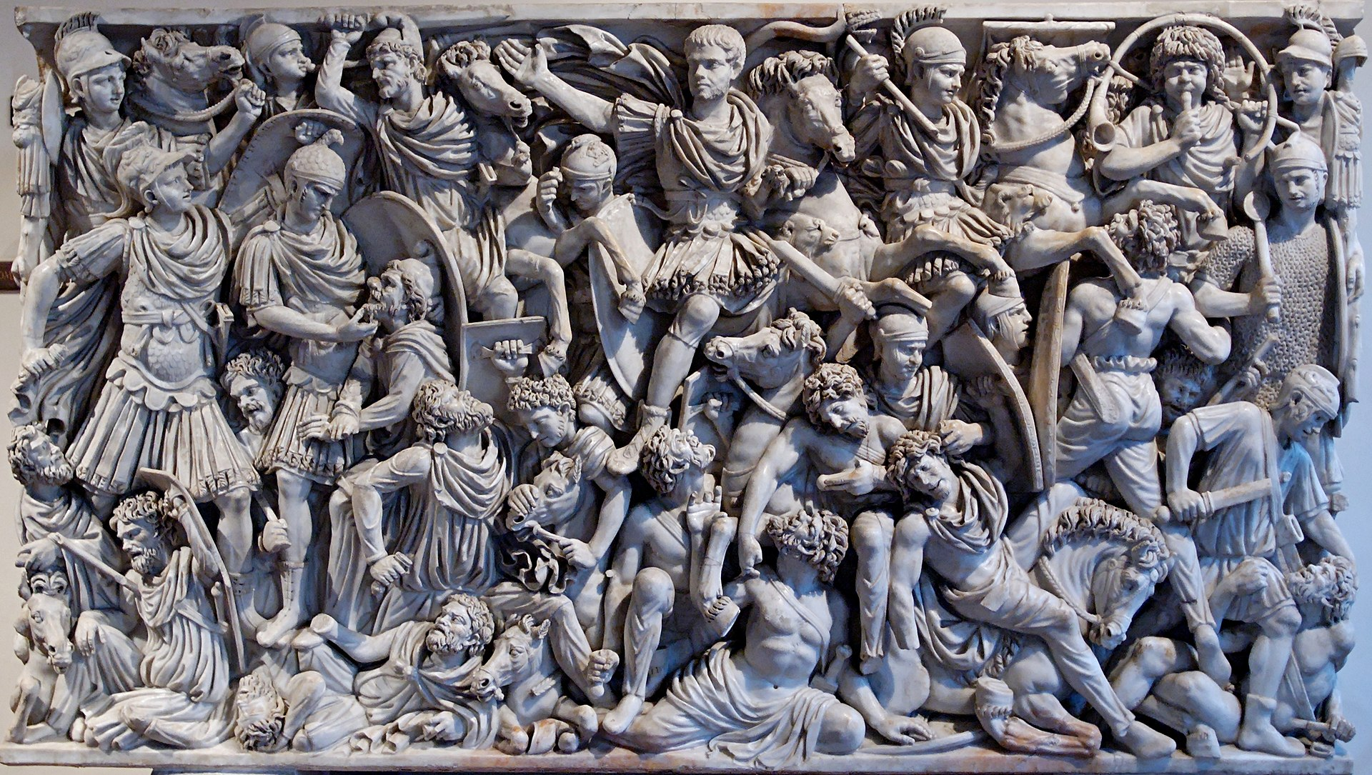
Battle over the Institutional Repository
Image title: Relief panel of the Great Ludovisi sarcophagus
Image source: https://en.wikipedia.org/wiki/Ludovisi_Battle_sarcophagus

Slide 5
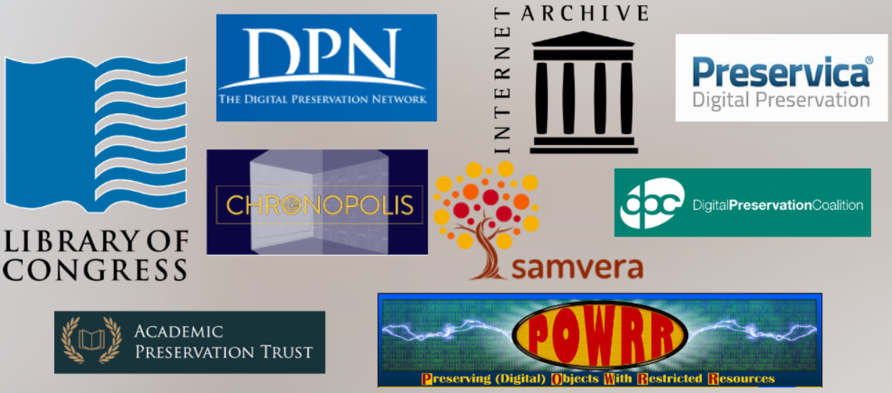
(Some) Organizations Addressing Digital Preservation Standards and Tools

Slide 6
What is your library’s digital preservation policy?
Focus on Born digital materials, digitized materials with no corresponding physical version, and
Create preservation metadata: What has been done to the material up until this point? How does it fit into your preservation policy? How will we convey preservation plans for the material in the record?
Access ,etadata” What restrictions and copyright issues are applicable to the material

Slide 7
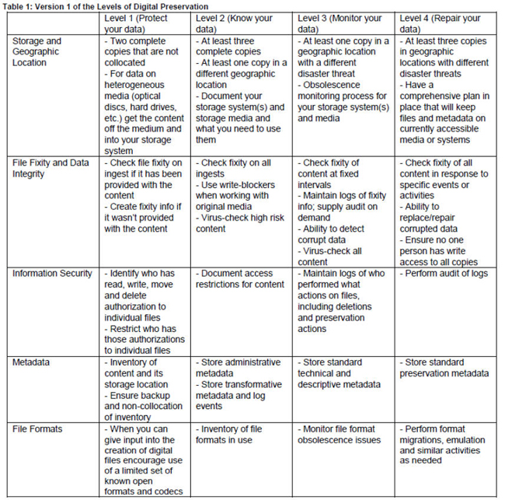
National Digital Stewardship Alliance

Slide 8
Links to GitHub Sites
Rendered site:
http://geokels.github.io/dig-preservation/
Source code:
https://github.com/geokels/dig-preservation

Slide 9
OAIS Reference Model
Use/Develop local documentation
It allows for consistency, reduces redundancy, provides context to work, creates historical record for future understanding

